Slide 1
Adaptive XML Storage
Adaptive XML Storage or
The Importance Of Being Lazy
Nihan ÖZMAN
26.10.2005
Instructor: Prof. Taflan Gündem

Slide 2
XML Data
Building an XML store means finding solutions to the problems of representing, accessing, querying and updating XML data.
Relational Database Systems rely on a fixed-schema of records to represent and manage data.
Being irregular in structure and content, XML Data does not seem to allow this approach.

Slide 3
This Paper...
Describes
  how the notion of database record has been extended and applied to XML storage
  how the resulted store abstracts the structure of the XML data from the actual storage format
The contributions of the paper are:
  (a) the problem definition for XML stores
  (b) an adaptive XML store and flexible index structures based on the existence of the XML store
  (c) an evaluation of lazy/partial index

Slide 4
Overview
Problem: The irregularity of the structure and usage of XML becomes a big obstacle in achieving good performance during accesing, querying and updating XML data.
New challanges
  Efficient query evaluation.
  Efficient access and retrieval of XML data.
  Maintainment of document order.
  Optimizing XML updates.

Slide 5
Overview - 2
Existing approaches
  lack a uniform way of representing and thinking of XML.
  focus on one aspect of XML storage and assume that the application will adapt to a particular usage pattern.
  function as all-or-nothing as regards indexing, where advantages gained by knowing all node information is lost in poor performance updates.
So, one can not achieve everything at once, but should focus on what it can achieve at a given moment, in a given usage context.

Slide 6
Overview - 3
This paper presents Ranges as a flat representation of desiderata for an XML store.
Ranges are logical units similar to tuples in relational databases, whose size and existence is defined by the application usage patterns
Ranges provides a lazy approach to storing, accessing and indexing XML data.
Ranges offer enough flexibility to have application-dependent indexing units.

Slide 7
XML Store Desiderata - 1
Requirements for an XML Store
  Store and access any instances of the XQuery Data Model
  Support for XML Update
  Allow optimization of reads and/or updates
  Indexes
  Support different Node Identifer schemas (support for stable and comparable identifies)
  Low storage overhead
  Support PSVI (Post Schema Validation Infoset)

Slide 8
XML Store Desiderata - 2
The XQuery Data Model supports a wide range of XML applications, either read-oriented or heavy-update scenarios.
PSVI avoids repeated evaluation of XML schema.
Low storage overhead incurs by minimizing the quantity of data actually stored.
Node identifiers are assigned, according to the XQueryModel to each node in the data instance.

Slide 9
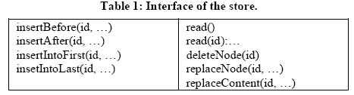
XML Store Desiderata - 3
The store should support read operations, entire data source or a single node
The store should support update operations that specify a node and allow insertions of the data relative to this node (as previous siblings, next sibling, first child or last child of the node)

Slide 10
Optimizing Reads vs. Optimizing Updates
Typical storage systems are faced with challenges of optimizing read operations or update operations required by the application
A store that achieves both optimality is a utopia. (Ex: The structures required to support read operations, fast indexes, negatively influence the performance of update operations)
In the paper, a middle approach is taken for optimizing one or the other depending on the application load.

Slide 11
XML Representation
The requirements for XML store have been fulfilled in the particular case of an XML store.
There are 3 important choices:
  the XML representation
  the definition of an arbitrarily granular unit Range
  the flexible index structures based on the existence of Range

Slide 12
Choosing an XML Representation
For representing or storing, XML Data is either shredded on a relational database, special index structures or the combination of the two
There is usually a strong relationship between storing and representing XML on one side, indexing and querying it on the other side.
Current approaches do not seperate them.
The adaptivity requirement in this paper’s approach provides both data independence and flexible granularity.

Slide 13
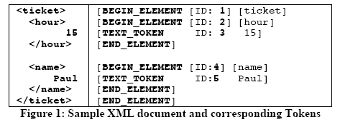
A Flexible Representation - 1
To denote each part of the XQuery Data Model, Tokens, that are a materialization of enriched SAX (Simple API for XML) events, are used.
Nodes in the XQuery Data Model, who must have an associated identifier, are also represented by a sequence of tokens

Slide 14
A Flexible Representation - 2
This representation of the XQuery Data Model offers :
  Complete representation of the XQuery Data Model
  Independence of the API used in the actual application (flat model as opposed to tree-based or event-based representation)
  Allows flexible data granularity (Token is the most granular unit and tokens can be grouped in more specific units)
  Post schema validation info set (Token sequence can also be associated to the XML schema type derived after a schema validation)

Slide 15

Storage Model - 1
The storage model of the XML data in the store presented consists of token sequences serialized in sequential blocks/pages in document order.
Tokens offer a flat representation of the XML data, independent of the actual data model of the application that uses the store.

Slide 16
Storage Model - 2
For example, each time data is inserted in the store:
  the corresponding tokens are generated and stored in the corresponding positions in the storage.
  blocks are allocated accordingly.
  Node Ids, requested in the XQuery DataModel are generated.

Slide 17
Implementing Database Records for XML
The interface to the store defines read, insert and update operations.
All operations are defined relative to a target node identifier. So, it is nodes corresponding to these identifiers that need to be quickly located.
Existing approaches to XML data storage take the options of full data indexing in order to optimize queries and accelerate access to specific parts of XML data.
In this way, updates are too expensive.

Slide 18
Discarding the Option of A Full Index
The advantage of a full index is the ability to quickly locate nodes.
On the other hand, it has main disadvantages:
  inserts and updates are more expensive
  storage requirements are very high
  the index grows in size for data-intensive applications and the vast majority of the entries will not even be used.

Slide 19
The Notion of Range
Range is a sequence of tokens.
Each sequence of tokens can constitute a range.
In presented model, a Range is implemented as a sequence of variable-sized tokens, where in relational database systems, a Record is implemented as a sequence of variable-sized fields.
Range is defined by the usage pattern of the application, not by a fixed schema.
An order between Ranges is needed to preserve document order of tokens.

Slide 20
The Range Index (Coarse-Grained Index)
The Range index is for locating the range corresponding to an ID specified in an update operation.
Ranges represents insert units where full index would have contained all IDs individually.
Range index contains less entries, it refers to an interval of identifiers.
Node identifiers need not to be stored together with the tokens they refer to. The advantage is better space utilization (low storage overhead).

Slide 21
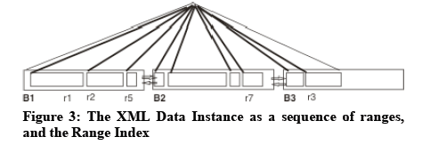
The Storage Model
Ranges are the logical storage units.
Storage level comprises chained blocks, which, at their turn, contain ordered ranges.
Document order is preserved through the chaining of blocks and through the ordering of ranges inside blocks.

Slide 22
Functionality of the Range Index
A Simple Usage Scenario - 1
There is an initially empty Data Source.
The operations performed:
  (1) insert 2 sibling Nodes (contains 100 nodes in total)
  (2) insert a child (40 nodes) as the last child of the node which is identified by 60:
  insertIntoLast(60,<<new data>>)
Tokens are created for the inserted data, and they are stored sequentially on the pages.
Node IDs are created, but only the ranges are inserted in the Range Index.

Slide 23
Functionality of the Range Index
A Simple Usage Scenario - 2
Effects of each step on the Range Index:
  (1) Allocate 100 identifiers for the inserted nodes, create range 1 with Ids 1-100 and store it in Block 1.
  (2) insertion of the child:
  (2a) Locate second node using the Range Index (id is in range 1)
  (2b) Locate range and offset of the end token of the node with the Id 60
  (2c) Split range number 1 in two (create range 3)
  (2d) Create a new range corresponding to the inserted data (2) and allocate 40 unique identifiers.

Slide 24
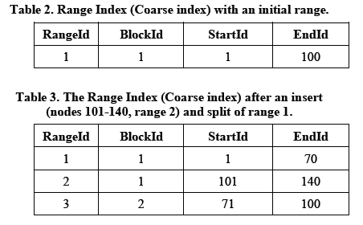
Functionality of the Range Index
A Simple Usage Scenario - 3
  (2e) Store the new range (Block 1) and insert the split range in the storage (Blocks 2)

Slide 25
The Lazy/Partial Index - 1
The notion of Range and Range Index allows to optimize update operations (fewer entries are inserted to the range index).
By the way, reads become more expensive. Nodes can not be accessed directly and additional lookups need to be performed.
The solution is the notion of Partial Index: using the advantages of the full index, but only when needed.

Slide 26
The Lazy/Partial Index - 2
The result of lookup operations, performed during updates, is inserted in the partial index, either:
  the range of a token
  the offset of a token inside its range
  the location (range, offset) of the end token of the node inside the range
  the position of the end token of the node inside.
The partial index stores information on the individual nodes: their exact ranges and offset inside the range.

Slide 27
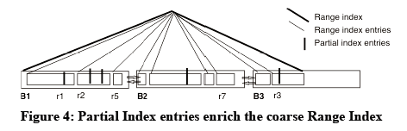
The Lazy/Partial Index - 3
The partial index is actually a combination between a real index and a cache.
The combination of the Range Index and the Partial Index achieves the goal of being adaptive, flexible and lazy in XML world
The aim is not to index everything, but only if and when needed.

Slide 28

The Lazy/Partial Index - 4
Referring to the previous example:
  (1) Considered empty at the beginning, inserting on empty data source does not create entries in partial index
  (2) Inserting a new node
  (2a) Locating node with Id 60 using the range index in range 1: a new entry is inserted in the partial index to indicate the range
  (2b) Locating the end token of the id 60,means that after the insert, the location of the end token is the range 3.

Slide 29
Orthogonality of ID Schemes
Indexing XML data relies heavily on the fact that nodes in an XML document are assigned an identifier
  update operations are expressed based on these identifiers
  indexes can be build on top of them.
Proposed model provides a separation from the API of the application:
  a range can span over several nodes, or over parts of a node (represented as a sequence of tokens)
  Ids of nodes are, orthogonal to the way of indexing.

Slide 30
Low Storage Overhead - 1
The Range Index is a coarse-grained index (lower storage overhead over full index)
The Range Index uses properties of Ids for locating the range of a node with the given id
{ID} is the set of Node identifiers in the store
{R} is the set of all ranges in the Range Index

Slide 31
Low Storage Overhead - 2
A Range is defined as a sequence of tokens in document order. By only storing the Identifiers of the first node inside a range, further decrease storage overhead can be obtained.
The Id schemes with this property generate the Id of the next token ID using a simple factory function:

Slide 32
Stable and Comparable Identifiers
Stable identifiers are the way to build indexes on the store:
  external and based on logical node identifiers.
Stable identifiers can be obtained by assigning unique integer number to nodes at insert times
This approach allows to define actual ranges of Ids
Ids inside ranges are comparable Ids inside ranges
A semi-stable document order at read time can be obtained (tokens are stored in document order and read sequentially)
The combination of order between ranges and order of ranges in the storage, can also be put in connection to partially-stable identifier schemes.

Slide 33
Experiments
Experimental Setup:
  Based-on relational database,
  Java and JDBC used
  Pentium 4 2,8Ghz/512MB RAM, running SuSe Linux9.0, and using a MySQL

Slide 34
Predictions
The identifier scheme associates unique integer values to each node, at insert time.
Only ranges become entries in the index.
A memory-based partial index adds information on the location of tokens inside ranges (begin and end token)

Slide 35
Parameters
The parameters that influence the results of benchmark:
  size of the ranges
  number of the ranges
A course-grained index means low update overhead but large overhead at read and lookup.
An index containing many entries leads to performance decrease at insert time.
The partial index improves reads especially in the case of more coarse-granular range sizes, as it builds entries lazily (cache-like)

Slide 36
Micro Benchmarks
inserts,
sequential reads
random reads of small pieces of data in the presence of a
  full index,
  range index,
  respectively the combination of range index + partial index
The metric is kilobytes/second (read speed, relative to data size).

Slide 37
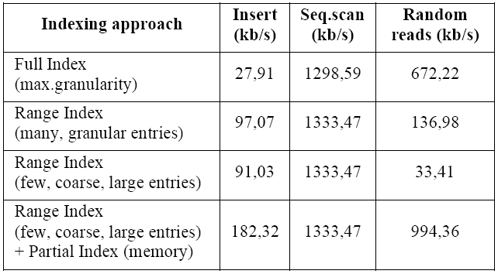
Experimental results:
Lazy indexing in XML storage

Slide 38
Results
The results reflect the expected behavior
The Range Index clearly brings advantages in what regards update speed: less entries are entered the index
As the number of entries increases,
  the advantages diminish (many,granular entries)
The Partial Index helps to achieve cheaper reads and lookups
  (especially when the range index is coarse)
More optimizations of the read/update/storage overhead is considered.

Slide 39
Related Work
Abstraction of tree model of the XML data is used to define partial indexes.
Usage of variable-size range and varying granularity are not entirely contained.
Logic identifiers have not been studied

Slide 40
Conclusions And Future Work
The paper describes a data representation and model of an XML store, inspired by the notion of records in relational databases.

Slide 41
Advantages
Independence of proposed data format from the API used by the XML application
The possibility to adapt to the application pattern
The store achieves this by
  lazily creating its storage and index structures optimizes for reads or updates according to how the application focuses on one or the other.
  the process is transparent to the application.

Slide 42
Aspects To Explore
The effect of functionality of the partial index
Structural properties of the actual elements of the XQuery DataModel
Concurrency
Non-relational world
  the principles of storage already defined in the context by relational database systems,
  The issue that differs from the relational world is the necessity to always maintain the order between ranges

